Slide 1
DS 6306
Case Study 1
Anthony Burton-Cordova, Daniel Chang, Yixiao Deng, & Xavier Mojica
Notes:
Anthony

Slide 2
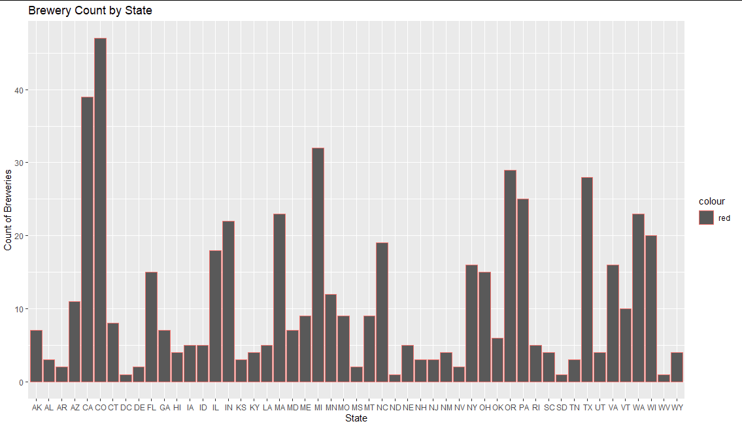
How many breweries are present in each state?
Notes:
Anthony

Slide 3

Address the missing values in each column.
To Address the missing values, we need to clean the data frame using an na.omit
Before this step, there were 2410 rows of data
After omitting them from the DF, we are now down to 1405 rows of data
Notes:
Anthony

Slide 4
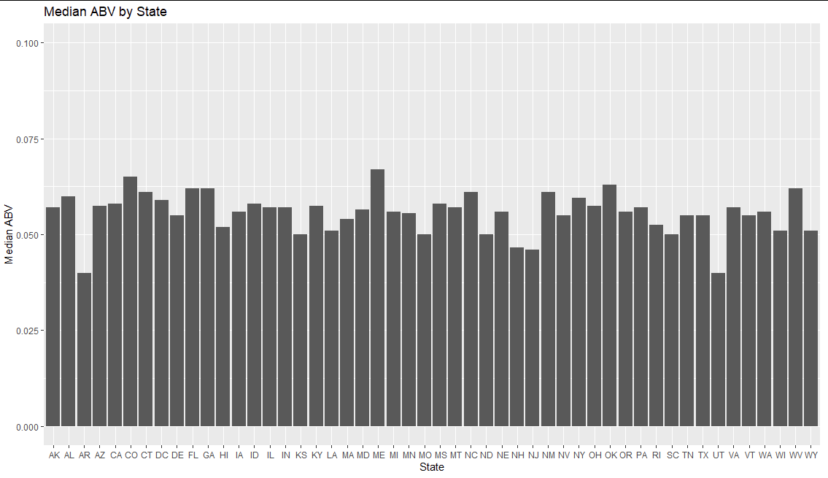
Finding the median alcohol content (ABV) and international bitterness unit for each state.
Notes:
Yixiao

Slide 5
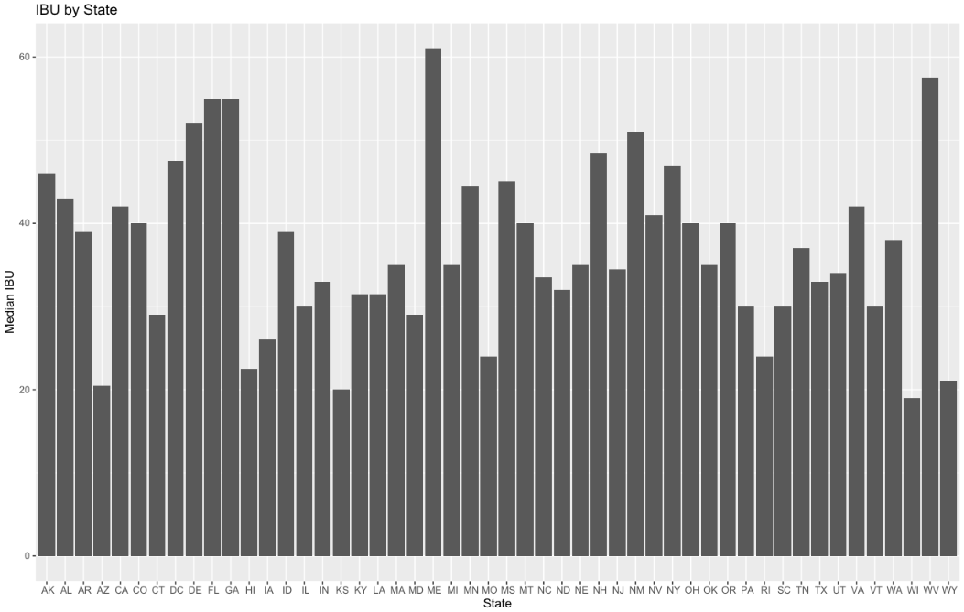
Finding the median bitterness (IBU) and international bitterness unit for each state.
Notes:
Yixiao

Slide 6
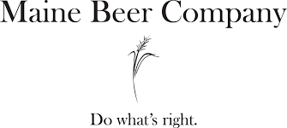
Which state has the highest median Alcohol By Volume (ABV)? Which state has the highest median bitterness (IBU)?
Maine has the highest median ABV of 0.067
Maine also has the highest median bittermess, with an IBU of 61
Kentucky has the highest overall ABV at 0.125.
Oregon has the highest overall IBU at 138.
Notes:
Daniel

Slide 7
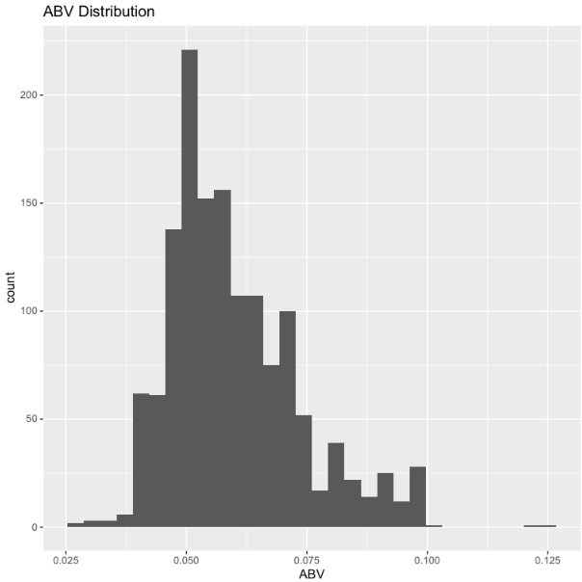
What does this all mean for ABV?
The Mean for the ABV is .06 which seems high relative to light, everyday beers (Bud Light, Coors Light, etc.)
The type of distribution shown on the right has most values centered around 0.052.
Max for ABV is at 0.12500 and min is 0.02700
The data is right skewed.
Notes:
Daniel

Slide 8
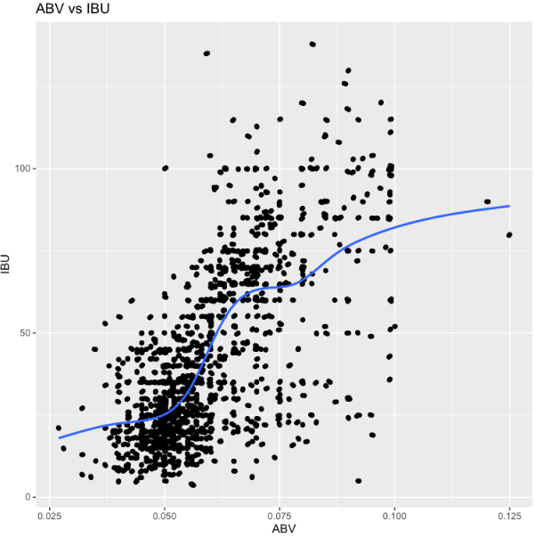
Is there an apparent relationship between the bitterness of the beer and its alcoholic content?
The relationship appears to be linear and positive but not a strong linear relationship.
There are many outliers from what can be seen.
Notes:
Xavier’s Slide : linear approach to model the relationship. between our variables

Slide 9
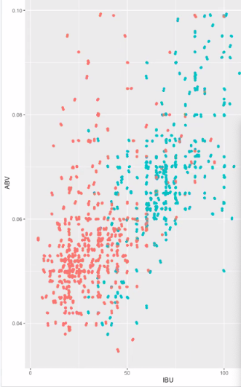
What is the difference in ABV and IBU of IPA’s vs other Ales?
IPA’s have, on average, higher Alcohol by Volume and rank higher in International Bitterness Units
Ales on average, score lower in Alcohol by Volume and rank lower in International Bitterness Units

Slide 10
What is our next target market?
These are the top 5 states for ABV
#1 Maine 0.067
#2 Colorado 0.065
#3 Oklahoma. 0.063
#4 Florida 0.062
#5 Georgia 0.062
These are the top 5 states for IBU
# 1 Maine 61
#2 West Virginia 57.5
#3 Florida 55
#4 Georgia 55
#5 Delaware 52

Slide 11
Questions or Final Thoughts?
Notes:
Xavier’s Slide

Slide 12
Peer Review
Anthony Burton - 10 (Unanimous)
Xavier Mojica - 10 (Unanimous)
Yixiao Deng - 10 (Unanimous)
Daniel Chang - 10 (Unanimous)
We all agree to give 10s for everyone

